Slide 1


Leveraging Large Language Models for Marketing Analytics

Slide 2

Table of Contents
Value Proposition
Project Goal
Hypothesis
Method
Experiments
Conclusion
Final presentation

Slide 3
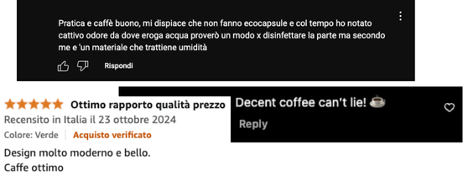

Project Value Proposition
For marketers seeking deeper insights on product launches, our analytics software transforms raw online comments and reviews into actionable metrics.

Slide 4

Project Goal
Developing AI software to accurately assess the real impact of a product launch by analyzing consumer sentiment across social media comments and third-party reviews.
Responsible
Consumption
and Production
Sustainable Development Goal:

Slide 5
Hypothesis
Large Language Models can be effectively used to extract valuable insights from consumer comments and reviews to enhance marketing strategies.
Specifically:
LLMs can effectively identify product-relevant comments.
LLMs can extract key product aspects from reviews sand comments and assign appropriate sentiments to each.
LLMs can successfully assess sentiment in comments and assign rating stars to reviews.

Slide 6
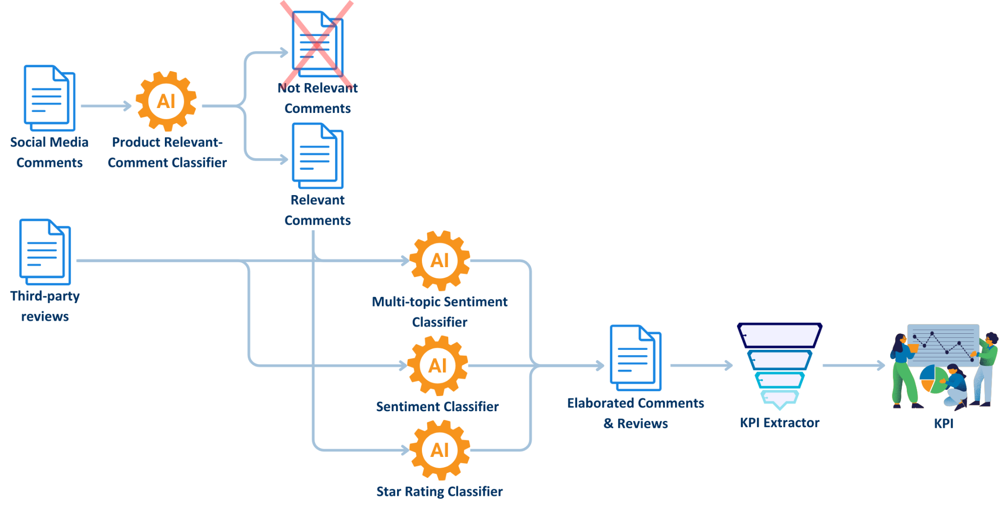
Method - Pipeline

Slide 7

Method - Classification Block and Models
The core of the pipeline is the classification block, responsible for all classification tasks. Its structure adapts to the model type used:
General-Purpose Models (Chat-like LLMs): Flexible and versatile for various tasks.
Specialized Task-Based Models: Fine-tuned for specific tasks, offering higher precision in narrow domains.

Slide 8
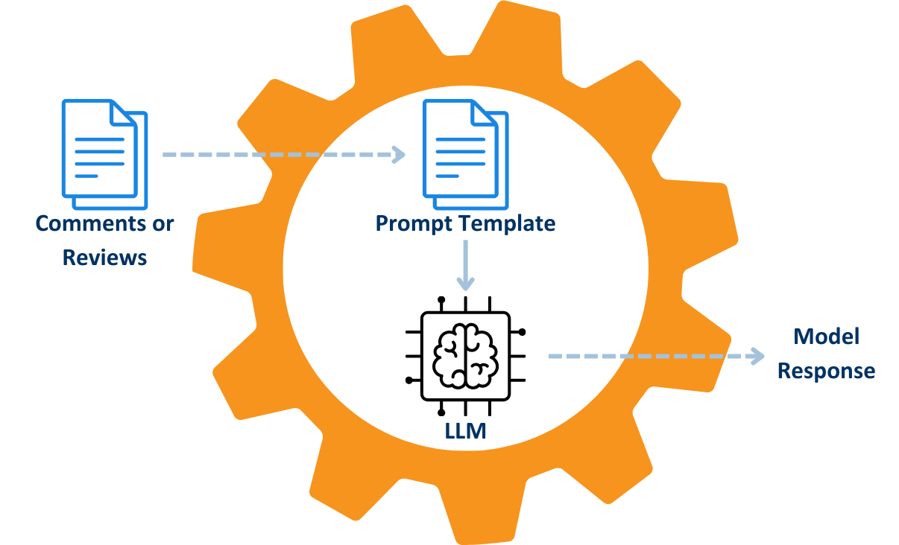
Method - General Purpose Classification Block
The general purpose classification block comprises two main components:
Prompt Template:
Clearly defines the classification task.
Includes examples (few-shot prompting only).
Specifies the structured output format for consistent model responses.
General-Purpose Model (LLM):
Processes the task-specific prompt (combining prompt template and input data).
Generates task-specific responses.

Slide 9



Method - General Purpose Models
Gemma2: large language model from Google, different versions: 2B, 9B and 27B
Llama3: large language model from Meta, 8B, 70B and 405B
Mistral: large language model from Mistral AI

Slide 10
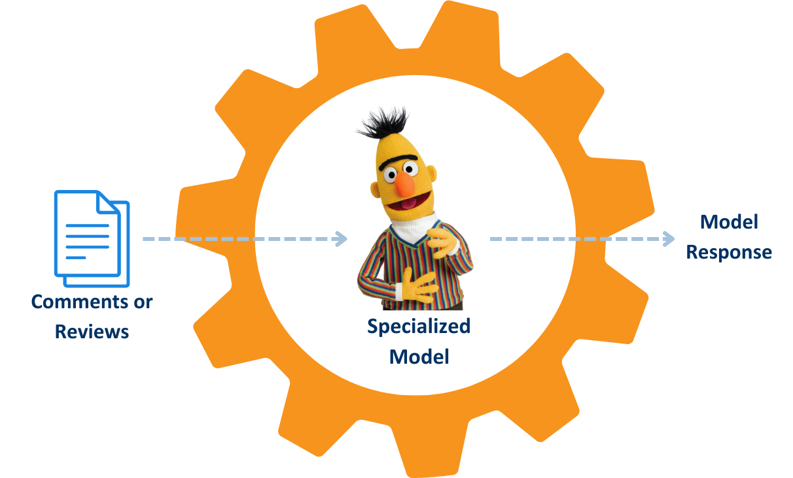
Method - Specialized Classification Block
The specialized model classification block comprises two main components:
Specialized BERT-base Model: Takes reviews or comments as input and generates a response based on the specific task.

Slide 11

Method - Specialized Models
Sentiment Classification
distilbert-base-multilingual-cased-sentiments
twitter-xlm-roberta-base-sentiment-finetuned
twitter-roberta-base-sentiment-latest
Star Rating Prediction
bert-base-multilingual-uncased-sentiment
multilingual-sentiment-analysis
*from Hugging Face

Slide 12
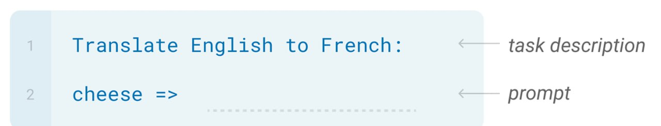
Method - Prompting Approach
Zero-shot:
The model predicts the answer given only the description of the task in natural language.

Slide 13
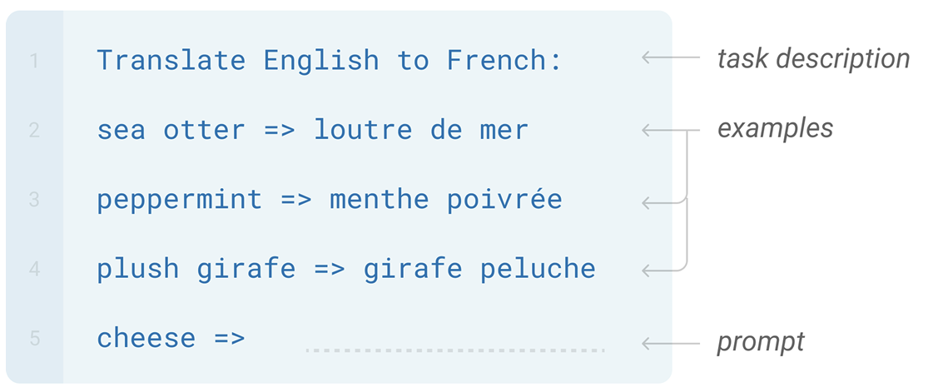
Method - Prompting Approach
Few-shot: The model sees a few examples of the task.

Slide 14





Experiments - Data
Data Sources:
Wonderflow
Digiming
YouTube
Instagram
Generative Models
Datasets:
Reviews
Comments
Synthetic Data

Slide 15
Experiments - Datasets
Reviews:
Records: 2930
Sampled records: 500
Star Rating label ration: 100%
Multi-Topic Sentiment label ratio: 95%
Tiny Eco Reviews: 79
Comments:
Records: 577
Labelled Comments: 0%
Tiny Eco Comments: 77
Synthetic Data:
Comments Records: 236
Reviews Records: 500
Labelled Comments and Reviews: 100%
Some reviews may have incomplete labels, e.g.:
“Excellent machine. Fair price and guaranteed quality.” - Positive Aspects: [“Price & worth”]
Where is “Coffee Quality”?

Slide 16
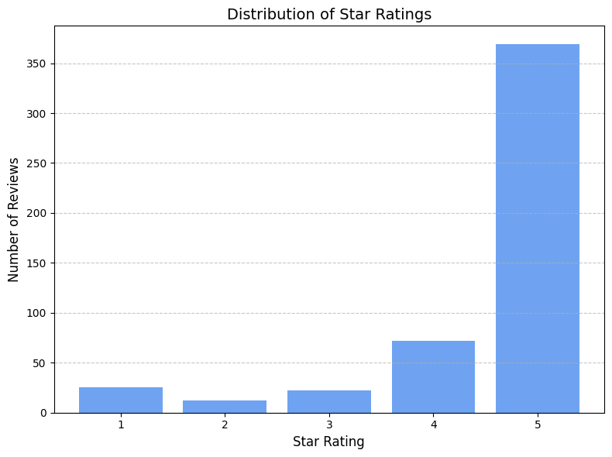
Experiments - Labels Distribution
Heavily skewed toward higher ratings!

Slide 17
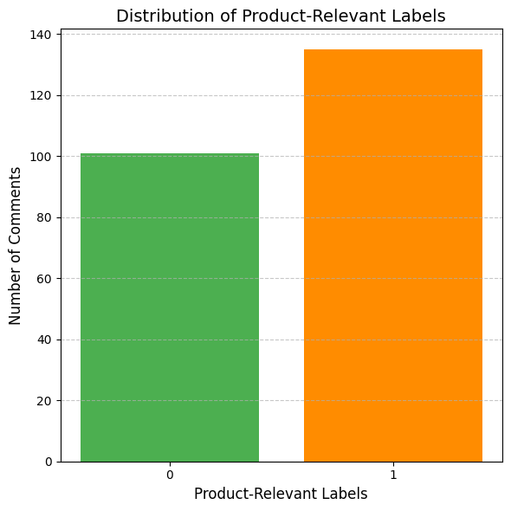
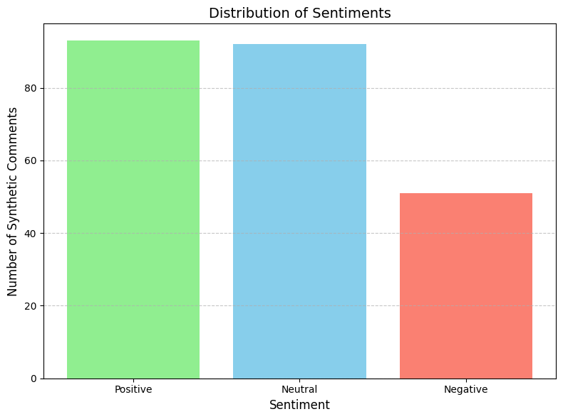
Experiments - Labels Distribution
Much more balanced!

Slide 18
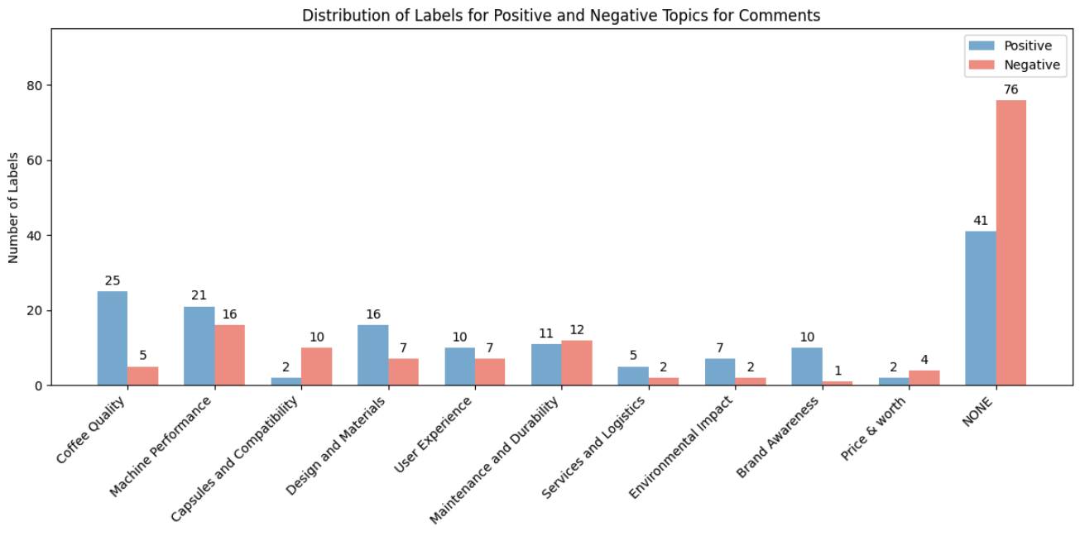
Experiments - Labels Distribution

Slide 19
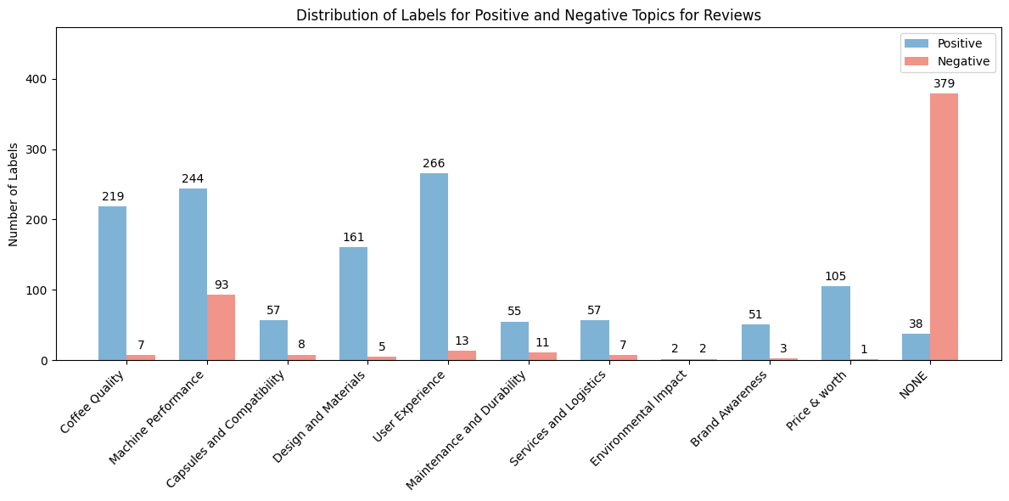
Experiments - Labels Distribution

Slide 20

Experiments - Tasks
Product Relevant-Comment Classification
Multi-topic Sentiment Classification
Positive Topics
Negative Topics
Sentiment Classification
Positive
Negative
Neutral
Star Rating Prediction:

Slide 21
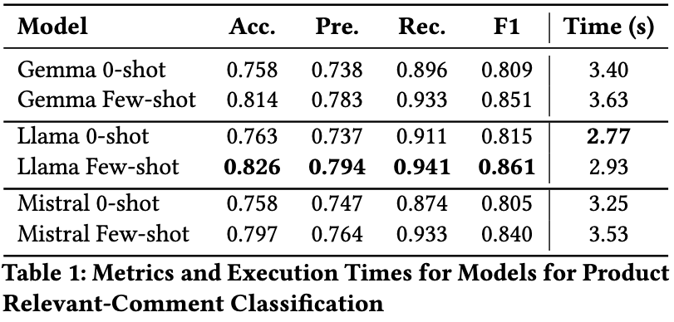
Experiments - Product Relevant-Comment
Classification
Data: 236 synthetic comments
Batch-size: 15 comments

Slide 22
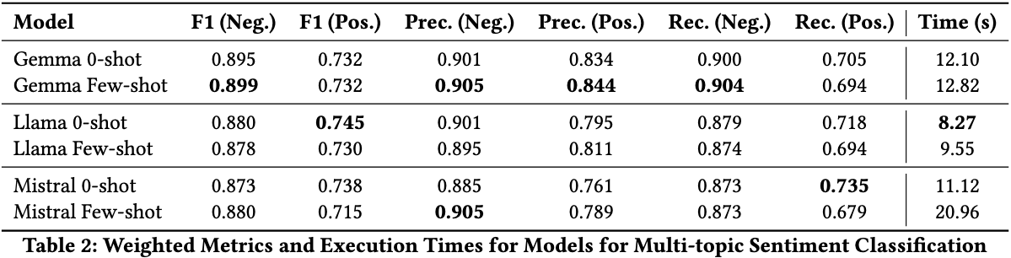
Experiments - Multi-topic Sentiment
Classification
Data: 500 labeled reviews + 236 synthetic comments
Batch-size: 5 comment/review

Slide 23
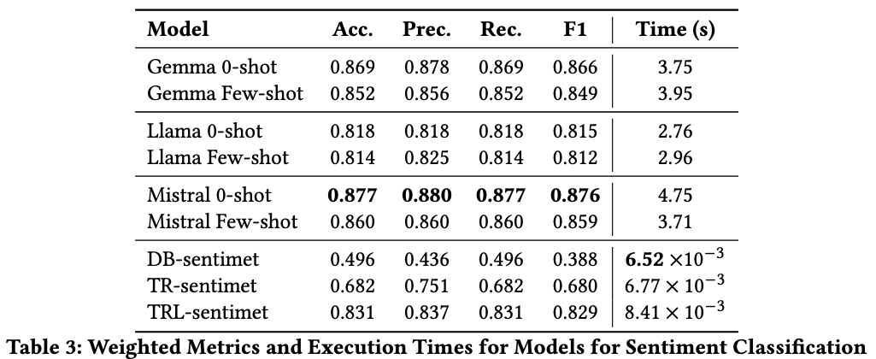
Experiments - Sentiment Classification
Data: 236 synthetic comments
Batch-size: 20 (general purpose model) and 50 (specialized model)

Slide 24
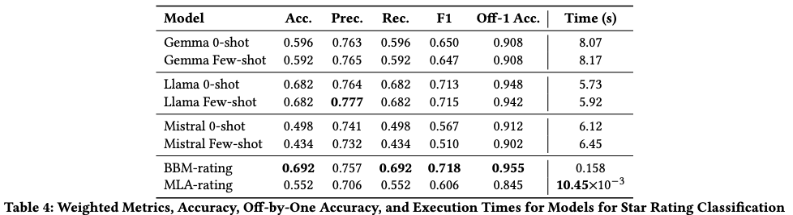
Experiments - Star Rating Prediction
Data: 500 labeled reviews
Batch-size: 20 (general purpose model) and 50 (specialized model)

Slide 25
Conclusion
We can conclude by saying that:
LLMs are able to identify relevant product comments, with an accuracy of up to 82.6%.
LLMs are able to extract product aspects from reviews and comments and assign sentiment to them, with an F1 score of up to 89.9% for negative aspects and 74.5% for positive aspects.
LLMs are able to assign sentiment to comments and rating stars to reviews, with an accuracy of up to 87.7% and 69.2% (95,5 off-by-one) respectively.

Slide 26
Conclusion
In conclusion we chose these models:
Gemma 2 few-shot: for Product Relevant-Comment Classification and Multi-topic Sentiment Classification.
Twitter RoBERTa latest: for Sentiment Classification.
BERT base multilingual: for Star Rating Prediction.

Slide 27
Thank you
Alessio Gioè - Catalano Vincenzo - Tommaso Mazzarini

